Slide 1
SAGE Spring 2021: Puzzle Authoring and Survey Creation
Lalitha Madduri, B.S. in Computer Science, 2021
Supervised by Jeff Bender

Slide 2
Overview
Sprint 4: Finishing puzzles across conditions
Sprint 5: Creation of Qualtrics surveys for FS3
Sprint 6: User testing

Slide 3
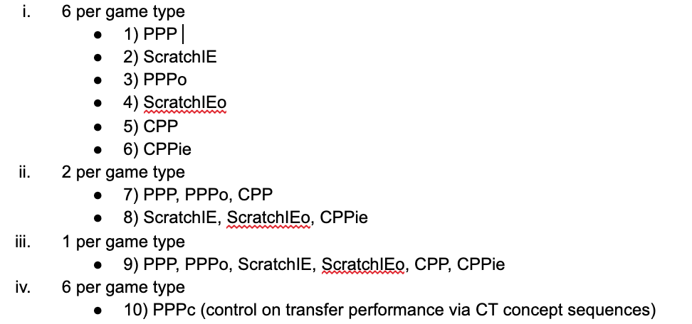
Finalized condition set
Notes:
Creating looping content for field study 3
Games across conditions (looping for all conditions except control on sequences)

Slide 4
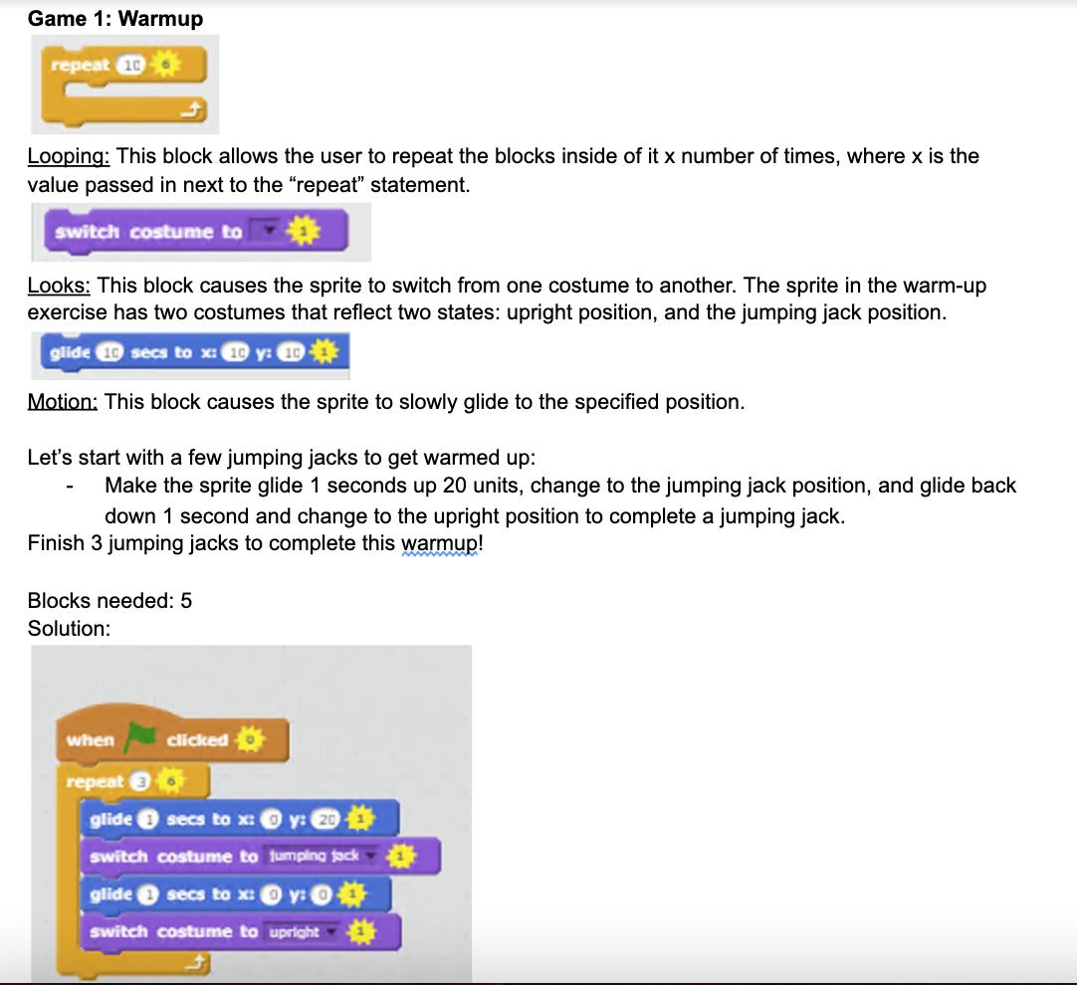
Instructions for looping concept warm-up
Notes:
Within this warmup, we introduce a new block to the user within the “looks” panel--previously, sprites would only say something, causing a speech bubble to appear. However, to further the gameful nature of SAGE, motion changes can provide motivating and dynamic scenarios that I wanted to implement

Slide 5
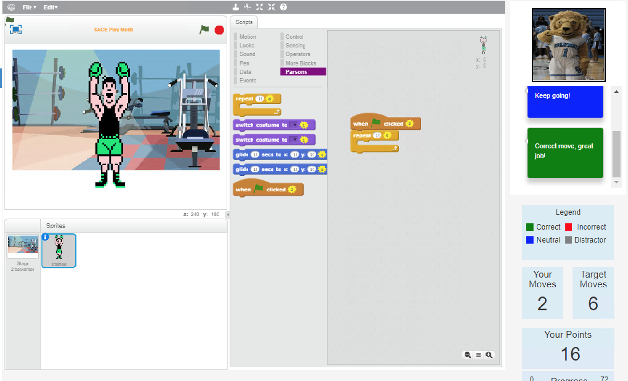
PPP: includes palette

Slide 6
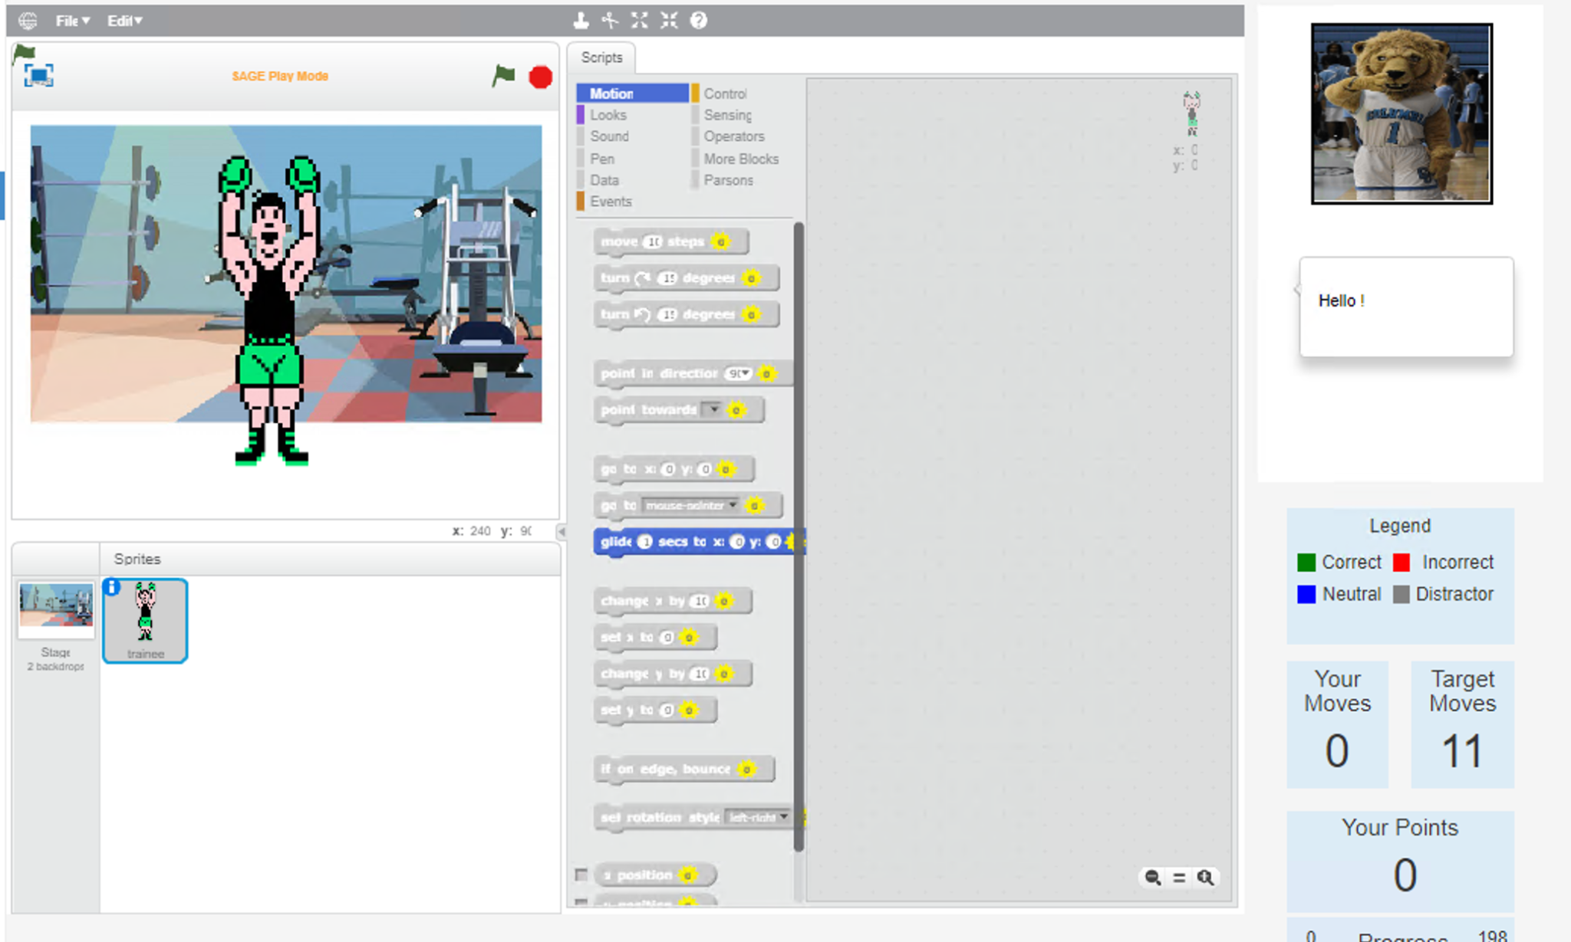
PPPie: no palette

Slide 7
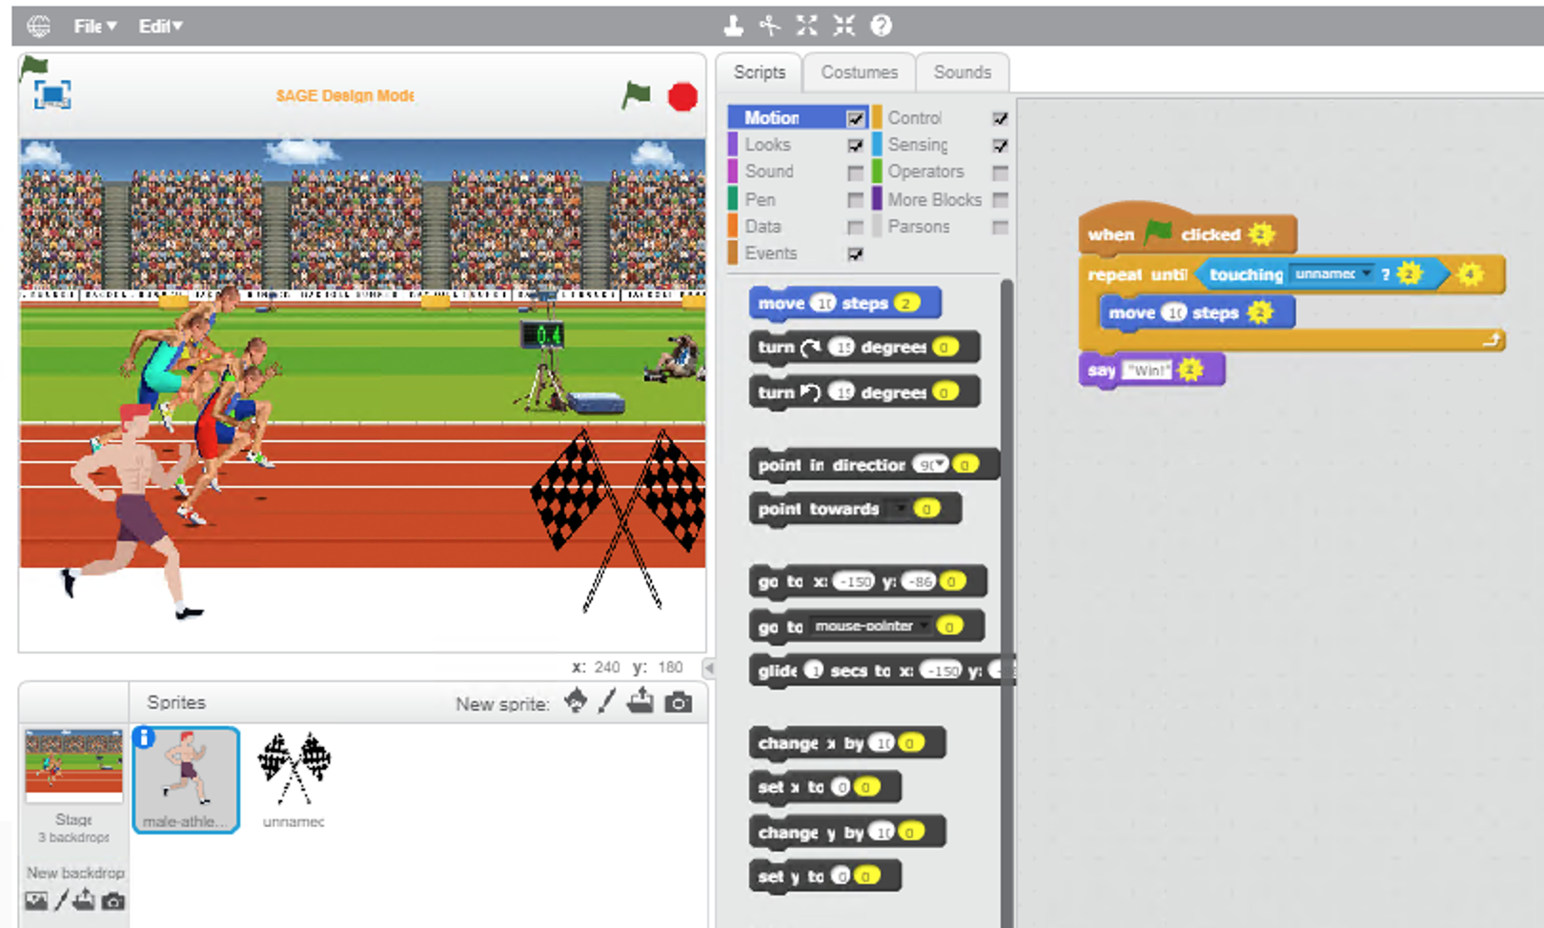

Slide 8
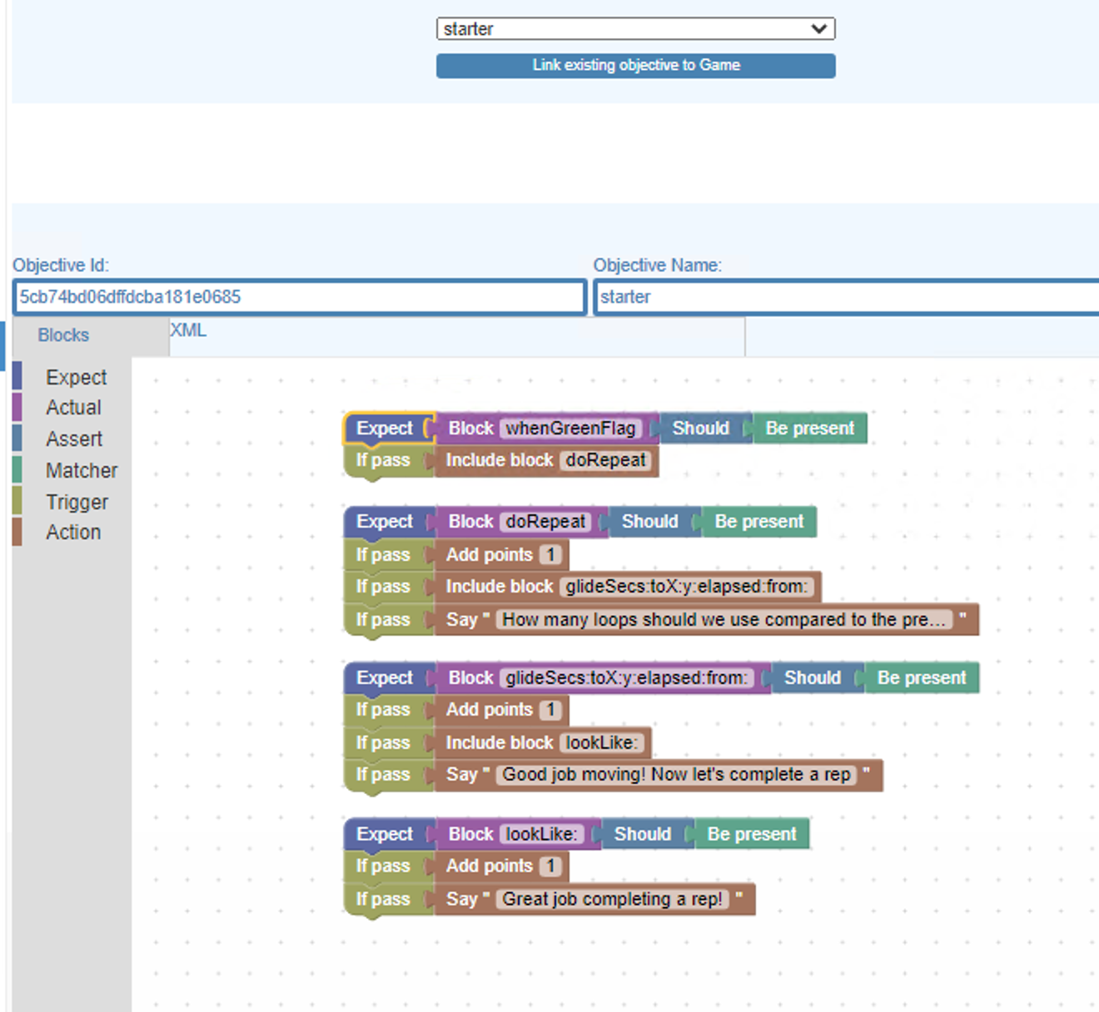
PPPo and ScratchIEo
Notes:
Objectives

Slide 9
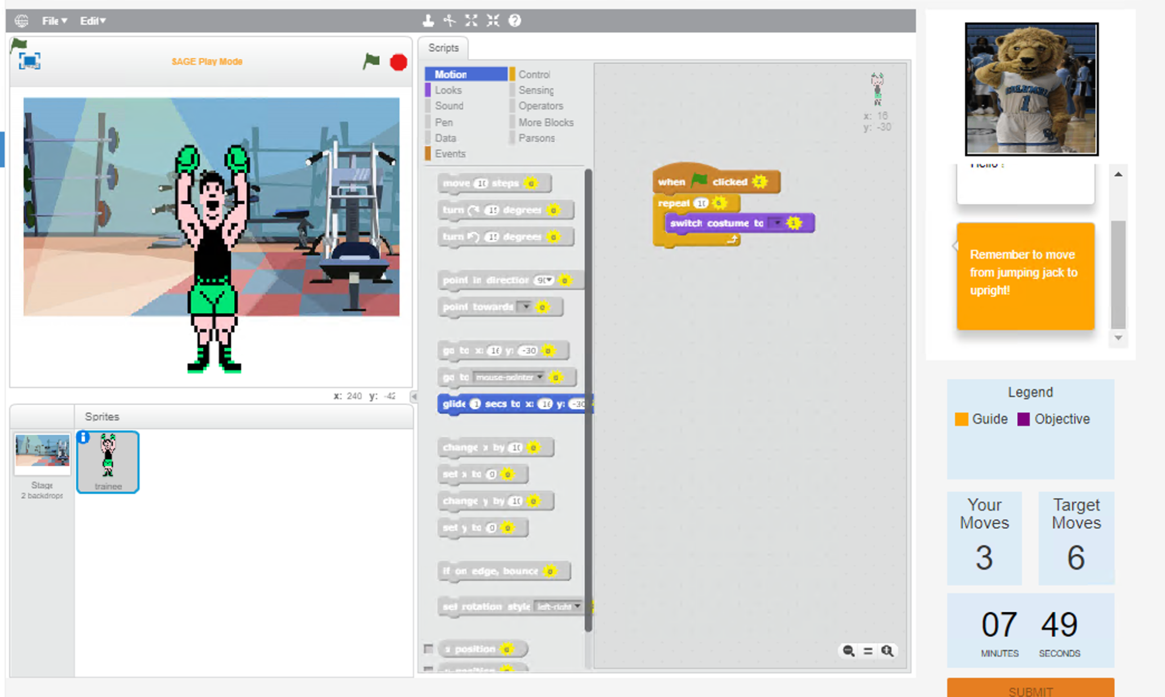
CPP and CPPie

Slide 10
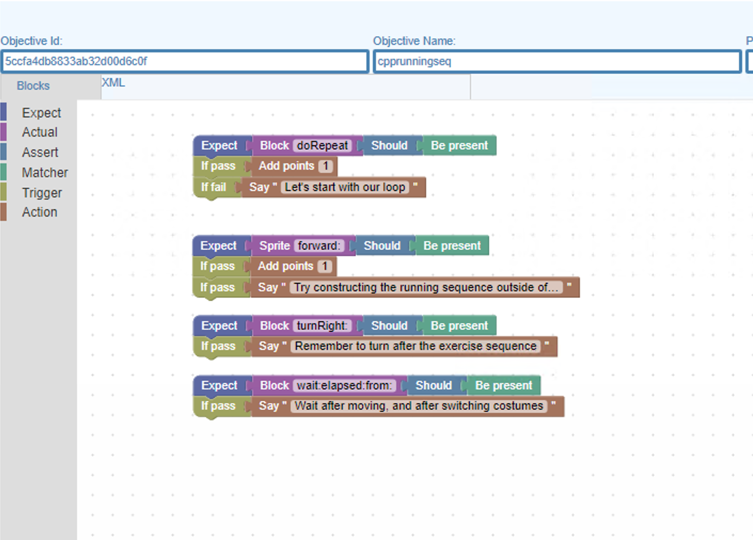
CPP and CPPie

Slide 11
Surveys
Looping pre-test and post-test in qualtrics
FS3 study guide

Slide 12
Preliminary User Testing
Primed testers on inspiration for SAGE, Scratch, and Parsons Puzzles
Provided login instructions
Select quest by condition
Read instructions and guide through familiarization puzzle, answering questions that arise
Allow users to complete puzzles
Note user pain points during puzzle solving
Notes:
User testing was done throughout the puzzle creation process so that there was feedback as I went along in creating puzzles

Slide 13
Preliminary User Testing
PPP: "The score seems to go up arbitrarily sometimes"
ScratchIE: “More guidance in where to be led in the beginning would be helpful”
ScratchIEo: “ Might be helpful to have a "say" for what type of block was unlocked as a result of an action being made”
“Guidance almost felt a little bit too hands-on at times if the following block was immediately unlocked”
Notes:
User testing was done throughout the puzzle creation process so that there was feedback as I went along in creating puzzles

Slide 14
Future work
Fixing bugs in objectives in order to complete objective user-testing
Testing puzzles comprehensively: going through study guide, pre-test, puzzles, and post-test
Testing updated qualtrics surveys
Contributions to FS2 writeup

